Slide 1
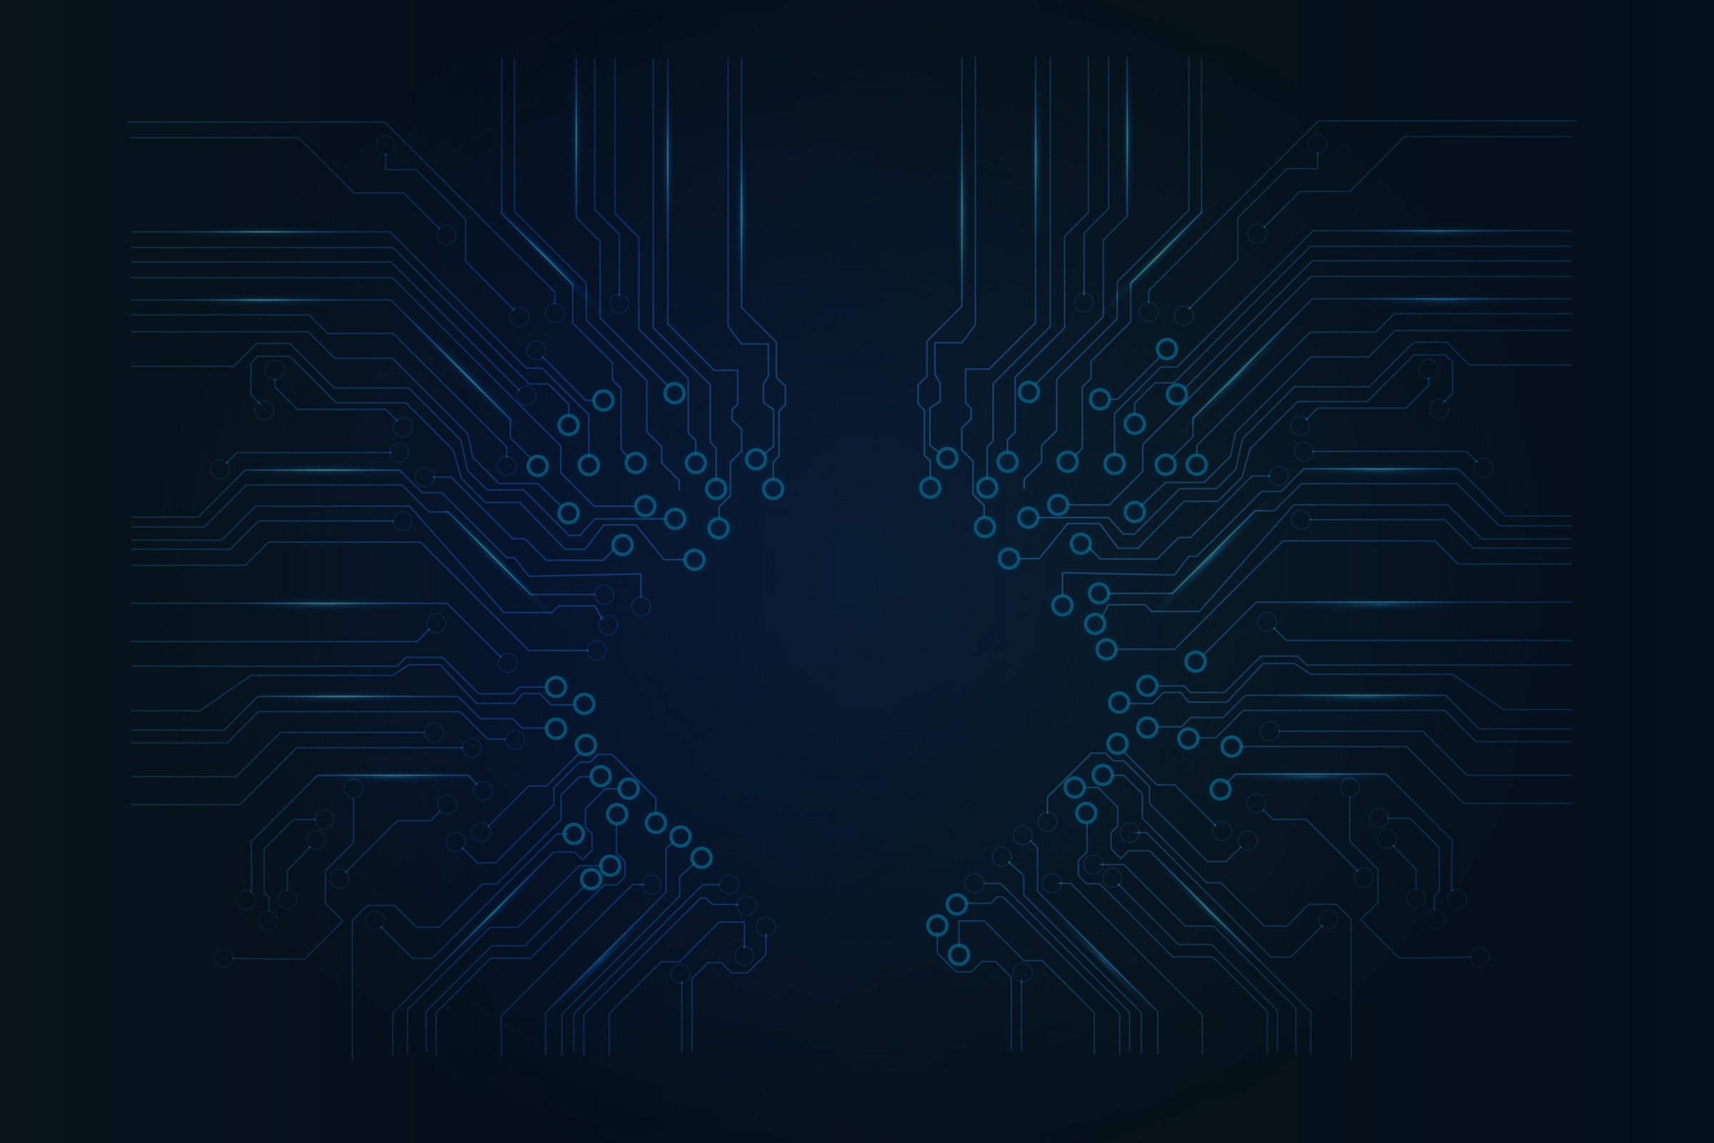
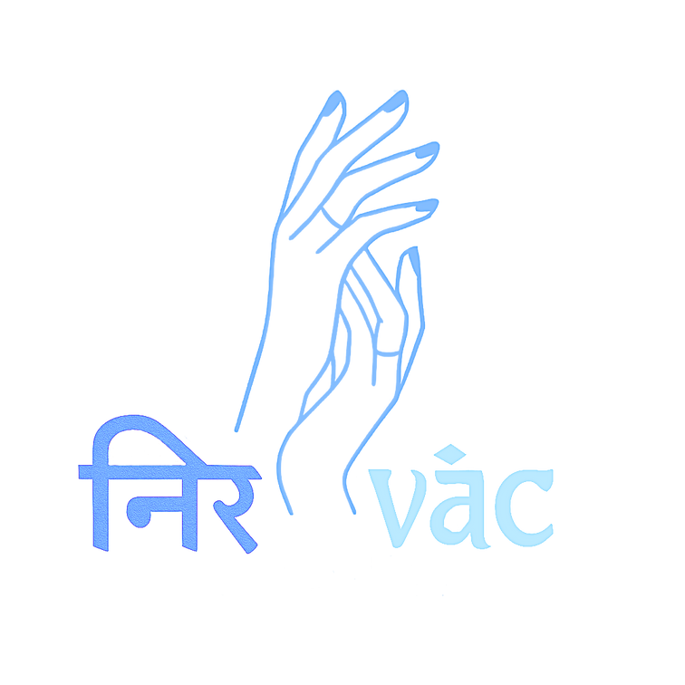
NIRVĀC
AI-BASED SIGN LANGUAGE TRANSLATOR
Bridging Communication Gaps with AI

Slide 2

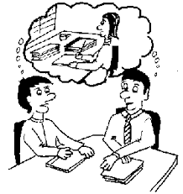
SCENARIO
A mother rushes into the emergency room, her child gasping for air in her arms. She's mute her hands move desperately in sign, trying to explain what’s wrong. But the hospital staff can’t understand her.
There’s confusion… panic… precious seconds slip away.
This isn’t just a story it’s real life for millions of non-verbal individuals. Whether in hospitals, schools, police stations, or banks, countless people are silenced by the absence of sign language support.
Our solution aims to change that by giving them a voice through technology.

Slide 3
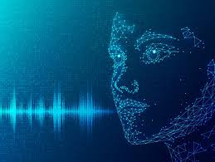
INTRODUCTION
In a digitally connected society, millions of Deaf and Hard-of-Hearing persons continue to suffer communication difficulties. Our project, IH3MU11: AI-Based Sign Language Translator, fills a fundamental gap by combining Artificial Intelligence (AI) and Large Language Models (LLMs) to provide seamless, real-time translation between sign language and spoken or written text.
This innovative solution uses computer vision to detect and interpret hand gestures and expressions, paired with LLM-based natural language processing to generate accurate and context-aware translations.
It understands intent, context, and emotion, making it a revolutionary step toward accessible and equitable communication for all..

Slide 4
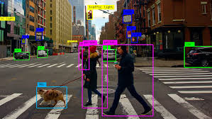
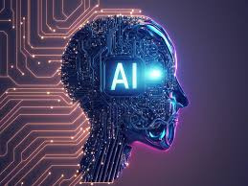
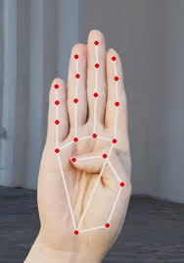
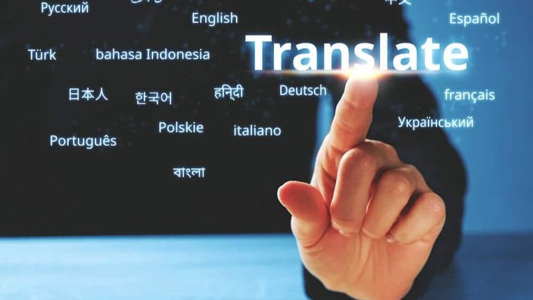
OBJECTIVE
Challenges in the Real World:
Over 70 million deaf/mute individuals globally face challenges interacting with the hearing world.
Manual interpreters are costly, unavailable 24/7, and not scalable.
Most mainstream communication tools (video calls, chat apps) lack real-time sign language interpretation or audio-to-touch/haptic conversion for the blind.
Smart assistants and AI tools are not fully optimized for non-verbal or gesture-based inputs.
Employers often hesitate to hire Deaf or Blind candidates due to communication challenges and inadequate workplace accommodations.
In hospitals or clinics, Deaf individuals may not receive proper care due to miscommunication.
Reliance on human sign language interpreters raises issues of privacy, cost, and availability, especially in rural or emergency scenarios.

Slide 5
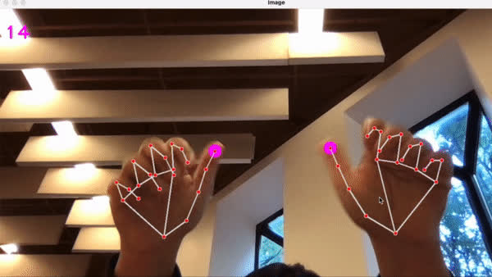
INNOVATION
Cutting Ede Tech :
Our solution leverages advanced AI-driven computer vision techniques, including Convolutional Neural Networks (CNNs), to accurately detect and interpret sign language gestures. Combined with Natural Language Processing (NLP) powered by Large Language Models (LLMs), it enables seamless translation from sign to text or speech making communication truly intuitive.
Features :
Customizations :
Unlike traditional static translation tools, our system offers real-time gesture recognition and instant feedback, allowing for fluid and natural conversations without delays. This dynamic interaction significantly enhances user experience and usability in daily life.
Aim to integrate tailored, domain-specific datasets including regional sign variants to improve contextual understanding and boost translation accuracy across diverse user groups. This personalization makes our model more inclusive and adaptive to real-world conditions.

Slide 6
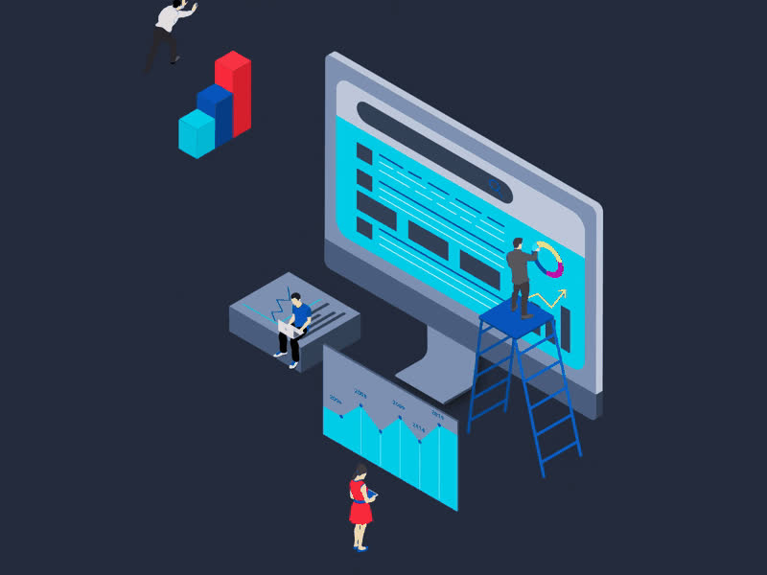
DATA ANALYSIS TECHNIQUES USED
Data Preprocessing :
Resized input images to 224×224 using OpenCV
Normalized pixel values for consistent model input
Dataset Handeling :
Structured dataset into folders by sign class
Split data into Training, Validation, and Testing sets
Model Evalution :
Tracked Accuracy and Loss during training (PyTorch)
Used Cross Entropy Loss for multi-class classification
Memory & Performance Optimization :
Used batch processing to avoid memory overflow Stored preprocessed data with NumPy / h5py for faster access

Slide 7
IMPACT :
lifeline for communication, inclusion, and dignity :
3. Bridging Social Gaps :
Inclusivity in Daily Life :
our solution allows Deaf and Mute individuals to freely express themselves in classrooms, hospitals, workplaces, and public places no longer needing to rely on interpreters or feel left out.
By breaking down communication walls, our solution fosters a society where everyone can be heard, seen, and respected regardless of their abilities. It drives a future that values accessibility as a right, not a privilege.
2. Empowering Education :
creates equal learning opportunities, offering interactive tutorials for sign language practice and comprehension. It also enables hearing individuals to learn sign language, promoting empathy and understanding.

Slide 8
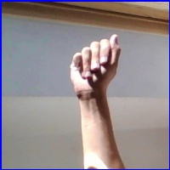
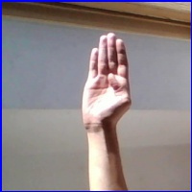
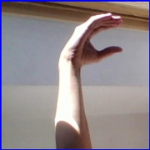
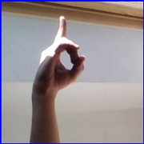
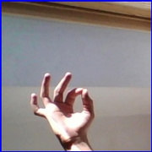
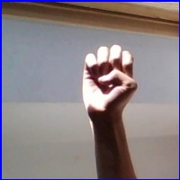
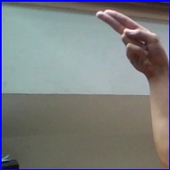
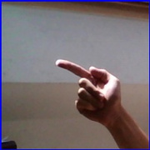

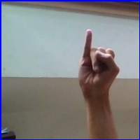
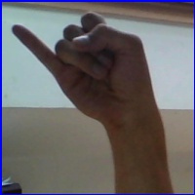
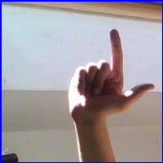
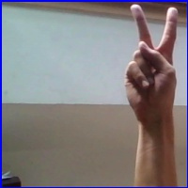
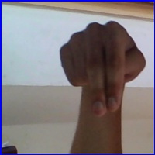
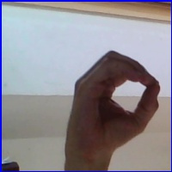
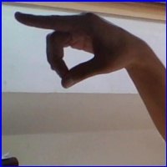
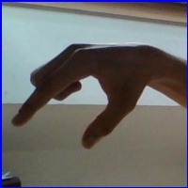
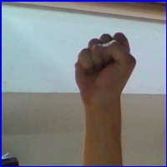
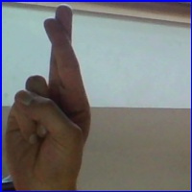
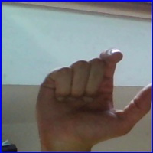
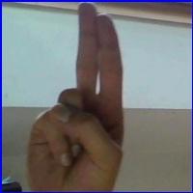
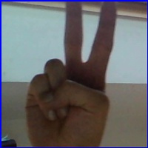
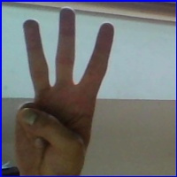
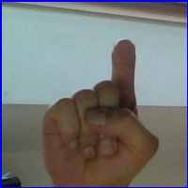
SIGNS :
A
B
C
D
E
F
G
H
I
J
K
L
M
N
O
P
Q
R
S
T
U
V
W
X

Slide 9
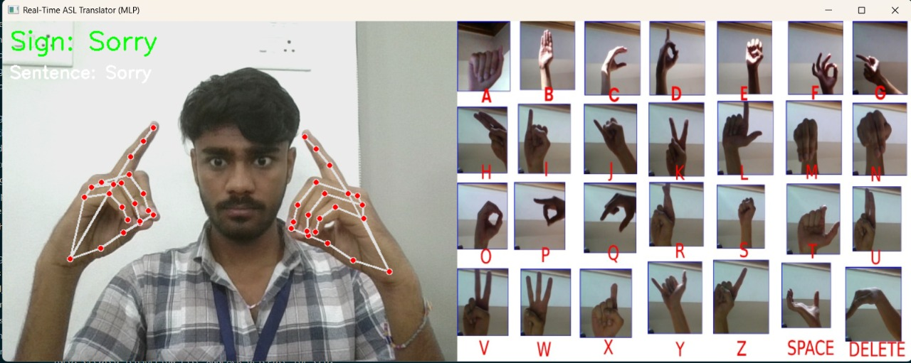

EXPECTED OUTCOME :
Real-Time Sign Language Translation :
By breaking down communication walls, our solution fosters a society where everyone can be heard, seen, and respected regardless of their abilities. It drives a future that values accessibility as a right, not a privilege.
Visual :
Interactive Sign Language Tutorials :
Users will receive visual indicators and confidence levels for each recognized gesture, helping them understand the system's accuracy and build trust and confidence in real-time use especially in sensitive environments like hospitals or classrooms
Embedded learning module will allow users to practice sign language at their own pace. Whether for personal use or educational settings, this fosters two-way inclusivity empowering both the Deaf and the hearing to bridge the gap.

Slide 10
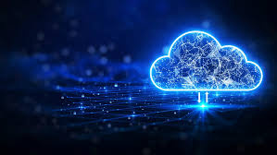
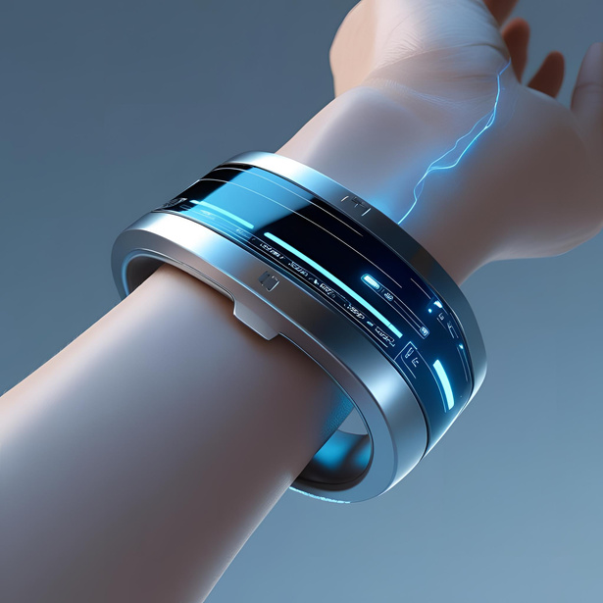
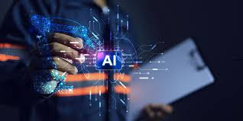
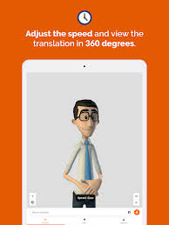
CONCLUSION :
With real-time gesture-to-text and speech conversion, our AI-Based Sign Language Translator helps Deaf and Mute people communicate. It is a scalable, inclusive, and ready-to-deploy solution that enables equitable access in everyday life, healthcare, and education. It was developed with open-source technologies and intelligent AI models.
What’s Next ?
Dataset Expansion
Model Enhancement with More Datasets
Collaboration with Educational & Deaf Institutions
Multi-language & Gesture Support
Mobile App Development
Explore Wearable Integration

Slide 11

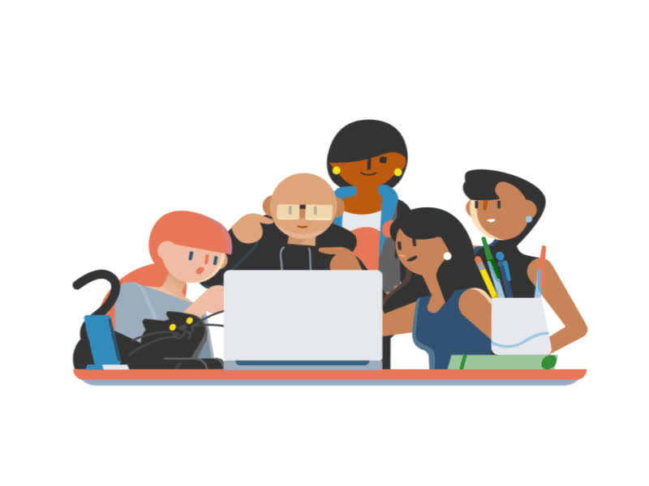
TEAM :
Raghav
Project Manager/ Team Lead
Nikshit
Front-end Developer
Ankit
NLP & Backend Developer
SriSaiKiran
Testing & Deployment
Anmol
Computer Vision Engineer

Slide 12
THANK YOU

